Slide 1

Policy-driven Security Management for
Gateway-Oriented Reconfigurable Ecosystems
Clinton Dsouza
Committee:
Gail-Joon Ahn, Chair
Partha Dasgupta
Adam Doupe
Presented in partial fulfillment for the degree: Master of Science

Slide 2
Outline
Motivation
GORE Computing
Policy Management Framework
Implementation
Demo
Evaluation
Conclusion
Future Work

Slide 3
Internet of Things and Big Data
IoT creates a network of physical objects with communication capability.
Generates large volume of data that may require computation-intensive processing.
IoT has evolved
Personalized to a user and capable of sharing sensitive data
Personalization of IoT gives rise to Internet of Everything.
Brings together people, process and things to make networked connections more relevant.
Increases the amount of personal data generated.
http://www.cisco.com/web/about/ac79/innov/IoE.html
Notes:
Motivation behind out research is the increasing popularity of Internet of Things.
IoTs create a network of physical objects, that are capable of communicating with each other and via the internet.
The increase usage of IoTs by users has led to the evolution of these devices where they have begun to collect personal user data to provide services such as health monitoring, personalized services to help through the day.
However, as with any computing device, data generation is always an issue. IoTs generate large amounts of data because they are continuously learning and collecting information from their surroundings. But where do they store it?
Simple Solution: Cloud

Slide 4
Big Data Growth
Notes:
United Nations Economic Commission for Europe
UNECE has projected an estimate data growth of upto 40 ZB by 2020.
This trend projection excludes the data generated from IoTs.
Cisco has projected that IoE will create a global data of 403 ZB/ Year by 2018.
This displays the impact IoTs will have on the economy, and the Big data problem they introduce.

Slide 5
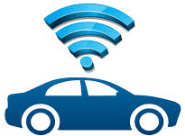



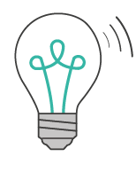



Current IoT Infrastructure
Internet of Things
Connected Devices
Notes:
Current IoT – IT infrastructure is centralized.
IoTs communicate with each other or directly with the cloud data center to upload or retrieve data for processing a users request.
Current cloud models are centralized. All the data is store in a large data center which is virtualized to provide on-demand access to users.
However, IoTs require a decentralized approach to data analysis.
They only require a small portion of a large data dump to achieve the necessary results for a request.
A paradigm is required that would sit between smart devices and cloud data centers.
A model capable to handle large user requests, and query minimal data from the cloud and store the data for short term use and intelligently determine data that is irrelevant.
Such a model would sit at the edge of the network.

Slide 6
Related Work – Fog Computing
Computing paradigm proposed by Cisco.
Proposed 3 unique layers in the Fog architecture.
Presented use-case scenarios primarily focusing on Smart Transportation System and Wind Energy.
Failed to take into consideration certain security criteria
Proposed a very abstract policy management framework.
Bonomi, F., Milito, R., Zhu, J., & Addepalli, S. (2012, August). Fog computing and its role in the internet of things. In Proceedings of the first edition of the MCC workshop on Mobile cloud computing (pp. 13-16). ACM.

Slide 7
Related Work – Edge Computing
Computing paradigm introduced by IBM.
Primary goal was to push Java computing to the edge.
Designed with a data-oriented approach in mind.
No clear policy or access control management specification or implementation.
Focuses on the distribution of applications rather than security.
Andy Davis, W. E. W., Jay Parikh, “Edgecomputing: Extending enterprise applications to the edge of the internet”, ACM conference on World Wide Web (2004).
Notes:
Both research approaches fail to account for : Data distribution and User Access provisioning and management.
Critical components for a paradigm designed to function at the edge of the network.

Slide 8

Gateway-Oriented Reconfigurable Ecosystems
Cloud
IoT Devices
Notes:
Before defining GORE, I don’t think you can put GORE term in the architecture
Our infrastructure like previous proposals is located at the edge of the network. However it is more diverse and distributed , but also localized based on the location of the IoTs.
By adding a middle layer called GORE, we enable the robust , real time communication and low latency provisioning of services by the GORE infrastructure.

Slide 9
Gateway-Oriented Reconfigurable Ecosystem (GORE)
Virtualized platform providing computing, networking, and storage services between end-devices and traditional cloud computing data centers.
Purpose: deliver a collection of resources to customers on-demand.
Vision: support for multi-tenancy, mobility, multi-agent orchestration, distribution and interoperability.
Distinctive characteristics: low latency support, diverse application hosting, and application localization.
Notes:
Application localization combined with data globalization.

Slide 10
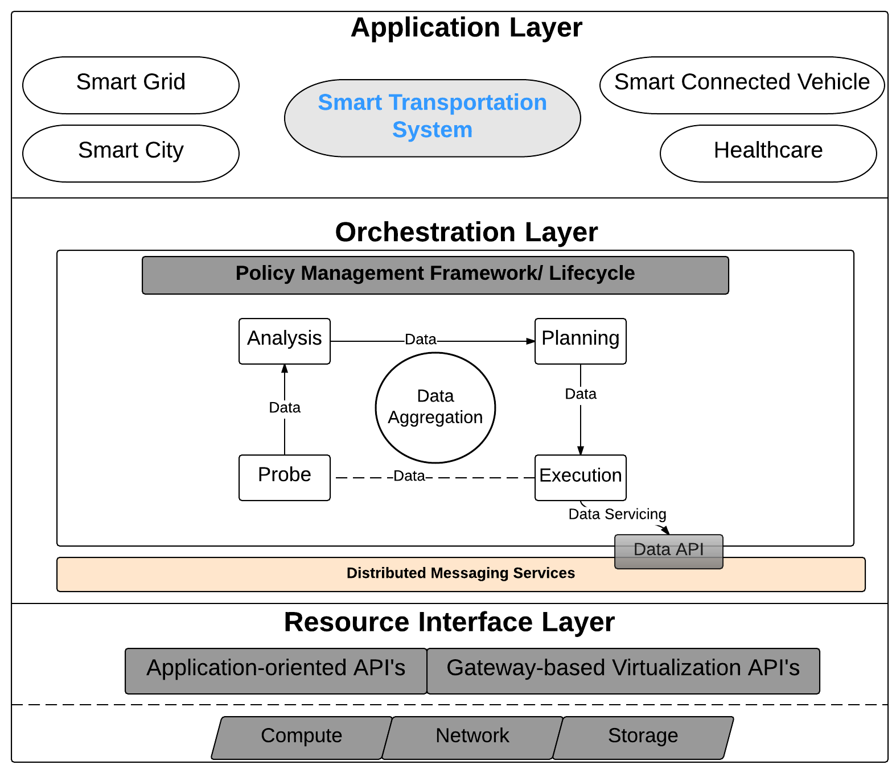
GORE Architecture
Notes:
Application Layer: Multi-tenant application hosting environment- “One size DOES NOT fit all”.
Orchestration Layer: Analysis and provisioning of resources and application services. Main Focus of our work.
Resource Interface Layer: Flexible usability experience- Ability for developers to program application specific modules for hosted applications.

Slide 11
Architecture Extensions
To realize the real-time, low-latency, and distributed nature
Gateway Node (GN)
Gateway Instance (GI)
Gateway Node
Localized cyber-physical access points that smart connected devices can request resources for consumption and relay information for intelligent processing.
Gateway Instance
Virtualized instances programmed to provide computing, networking, and storage (short-term) services to GNs dynamically on-demand.
Notes:
GORE architecture as a whole is robust.

Slide 12
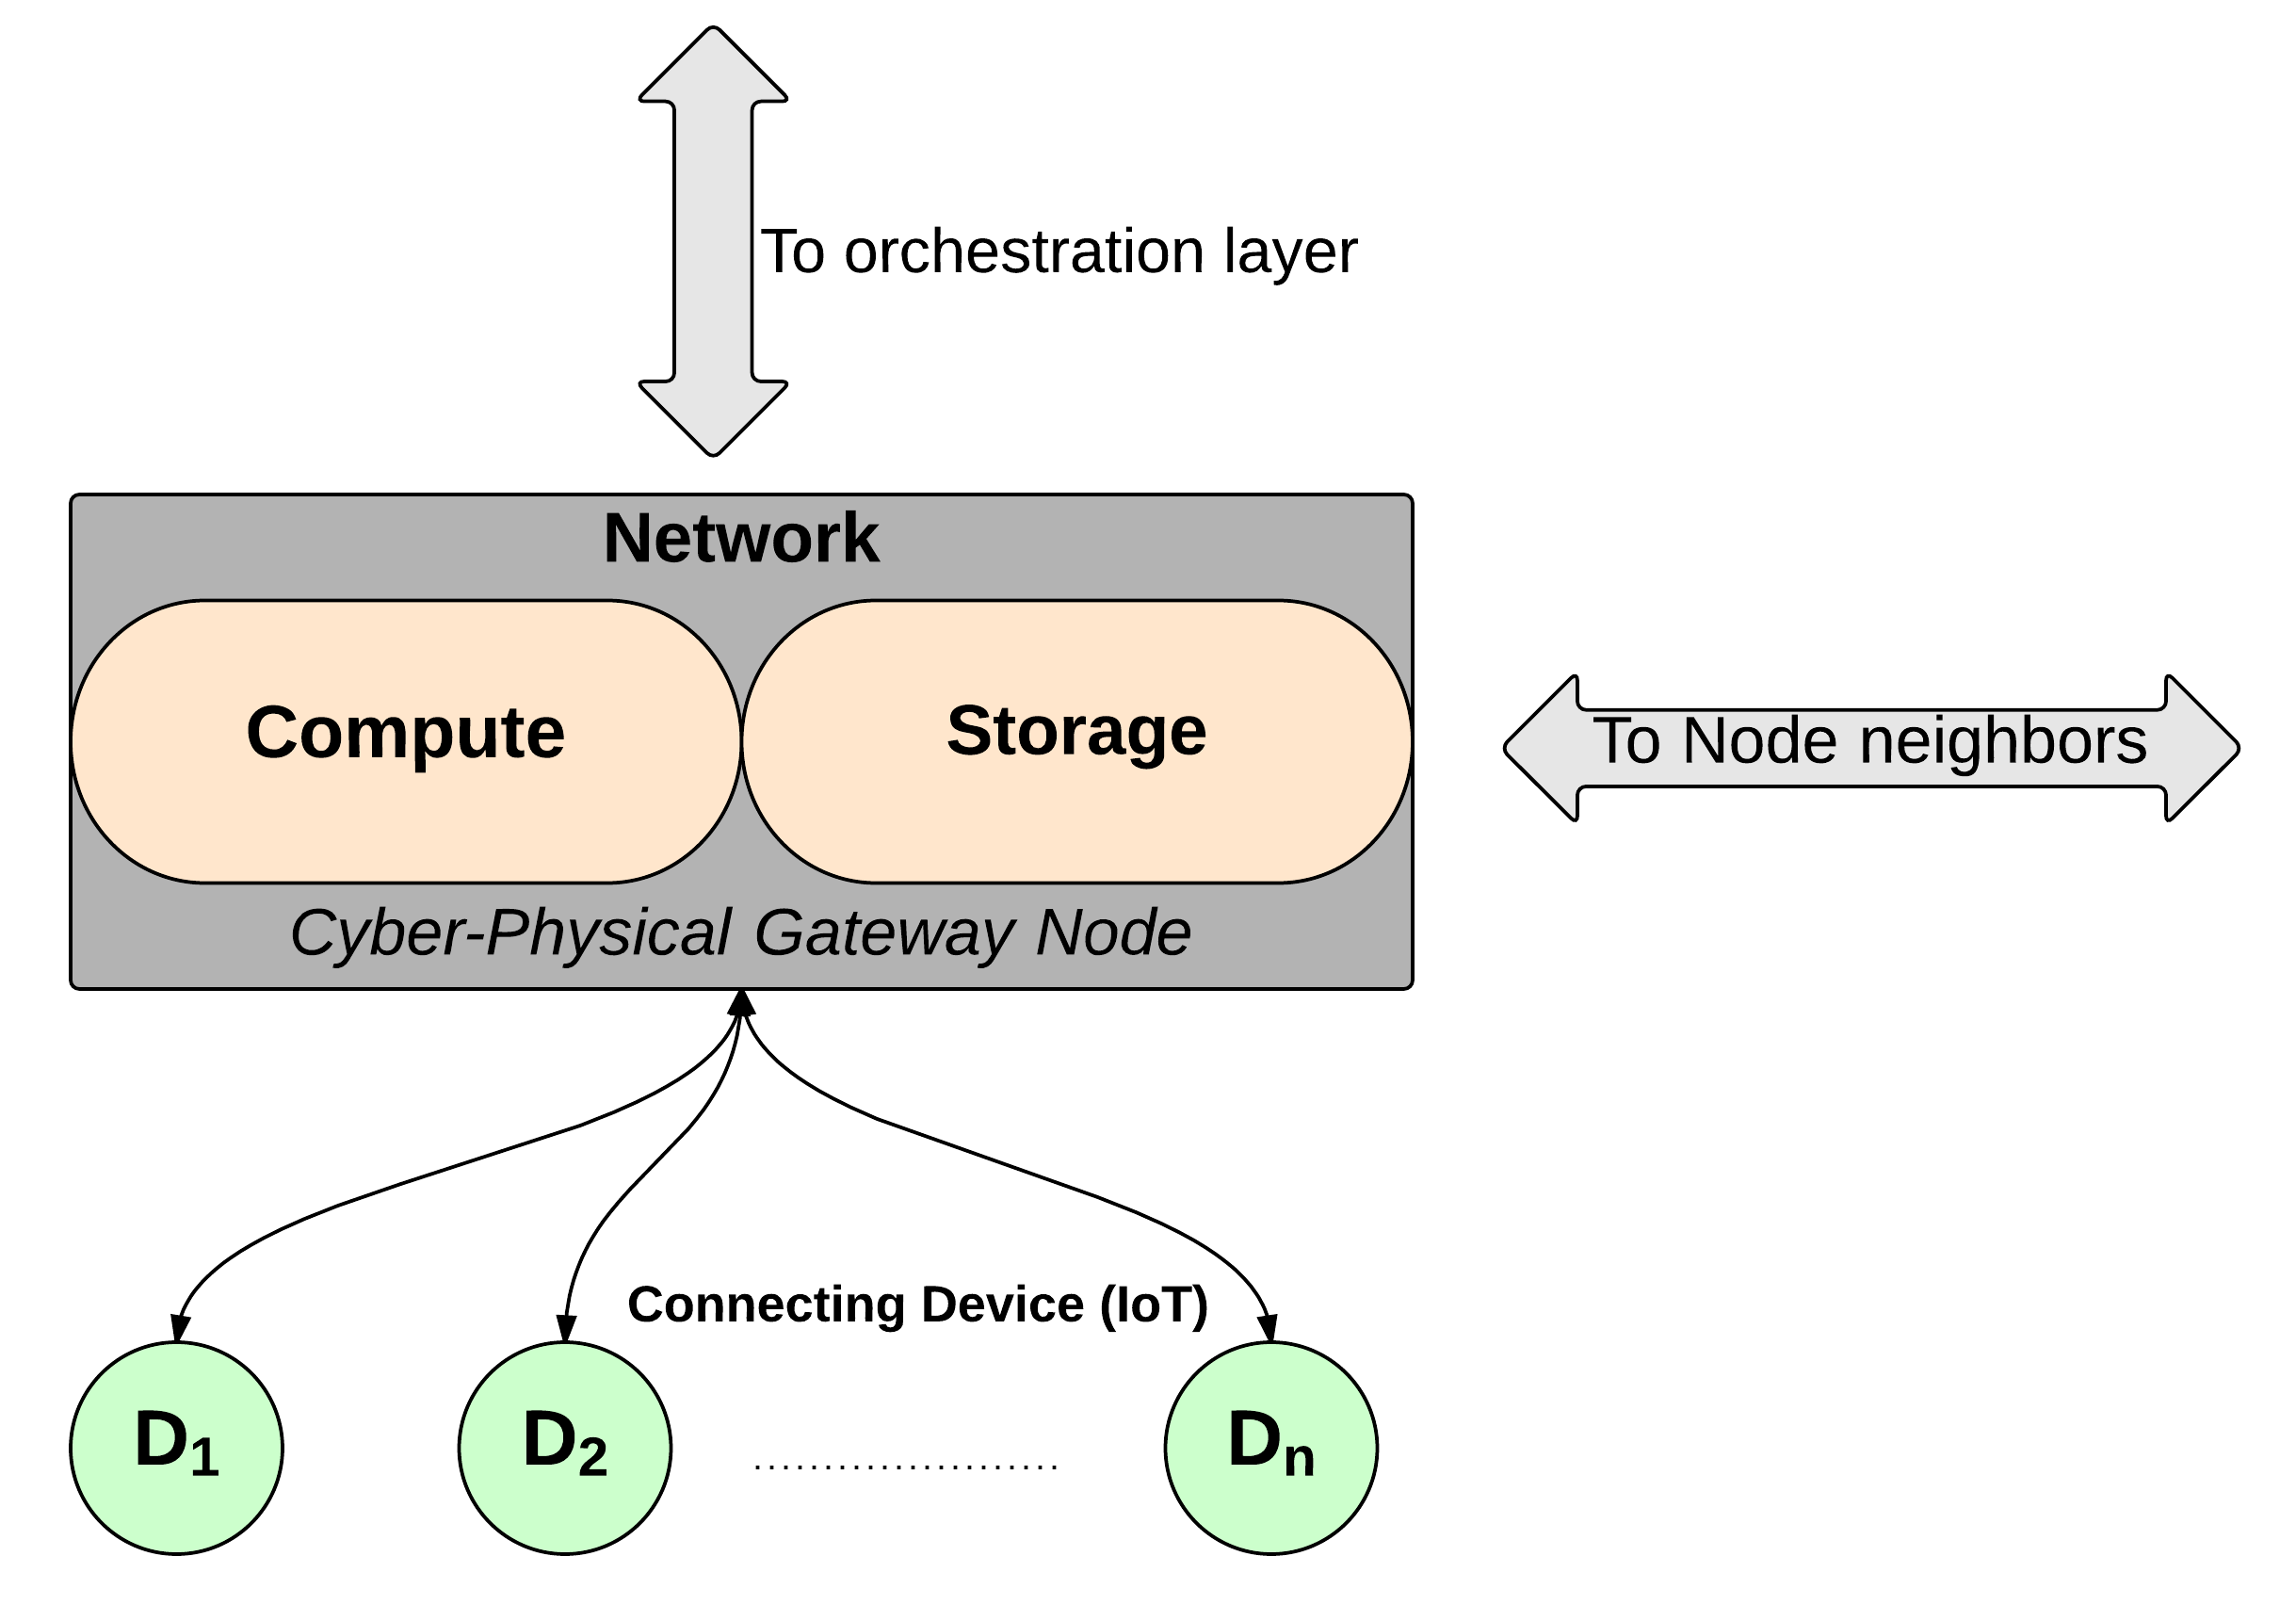
Gateway Node Interactions
Notes:
GATEWAY NODES
Heterogeneous in nature.
Capable of being deployed in diverse environments.
Core
Edge
Access network
Endpoints
End Outlook: ability to inter-communicate with adjacent nodes and diverse interacting components.

Slide 13
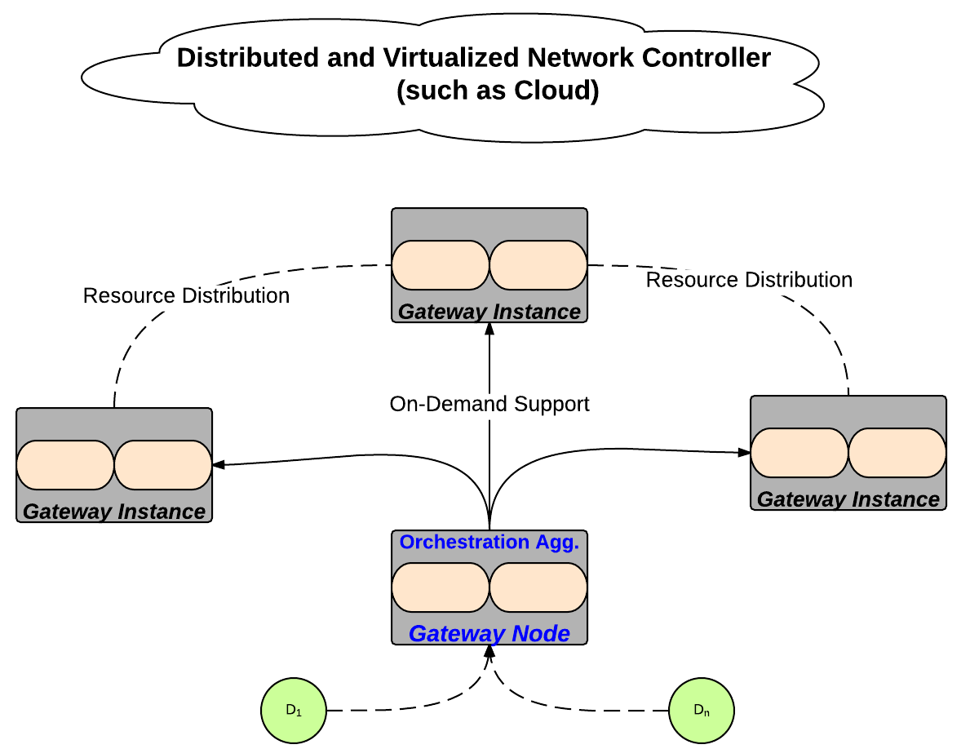
Gateway Instance Interaction
Notes:
GATEWAY INSTANCE
Mini cloud nodes with support for provisioning:
Computing
Network
Storage resources on demand
Capable of instantiating multiple instances on demand utilizing virtualization.
End Outlook: Support Gateway Nodes based on resource requirements.

Slide 14
Application Layer
Notes:
Application Layer: Multi-tenant application hosting environment- “One size DOES NOT fit all”.
Orchestration Layer: Analysis and provisioning of resources and application services. Main Focus of our work.
Resource Interface Layer: Flexible usability experience- Ability for developers to program application specific modules for hosted applications.

Slide 15
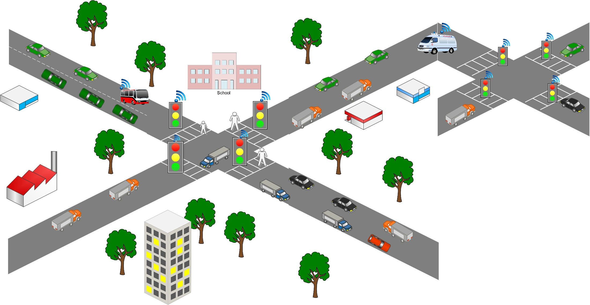

Use-Case Scenarios
School bus in transit
CV in transit
Emergency vehicle in transit
Collision detection
Notes:
Intelligent and Adaptive systems comprising of multiple components and real-time applications.
Goal: Accommodate dynamic traffic changes and provide real-time services to commuters, thus creating a safe environment for travel..
Car moving through traffic, attempting to reach its destination within a set time.
Connects to STL and requests for service eg. Direction service
ECV is travelling along the same path and is connecting to the same STL requesting for the same direction service.
Now a School bus is approaching the same intersection as the CV and ECV while a pedestrian is crossing the road while a car approaches.
While there are a lot of moving components attempting to receive services, there is also a need for all requests from these vehicles to be evaluated as fast as possible.
Based on the response, the STL will be responsible

Slide 16
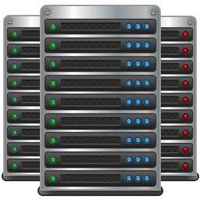


Connection Workflow
Cloud Data Center
Share/ Migrate Information
Edge Network- Gateway Node
Respond with service provisioning
Send Request / Travel Info
Connected Vehicle

Slide 17
Need for Policy Management
GORE infrastructure involves multiple interacting components including IoTs.
IoTs are distributive in nature and are owned by multiple users.
There is a need for disparate and diverse devices and components to interact mutually to exchange information in a meaningful manner.
This interoperability can be achieved through a robust policy management framework.
Notes:
Components interact with IoTs and cloud data centers.

Slide 18
Orchestration Layer

Slide 19
Orchestration Layer – cont’d
Policy Management Framework
Data Aggregation
Data API
Distributed Messaging Bus
Notes:
Modules of Interest:
Data Aggregation:
Intelligent node of the whole framework.
Customized by tenant.
Provides data massaging results based on acquired user data from IoTs.
Follows 4 generic data massaging phases:
Probing
Analyzing
Planning
Execution
Data API
Message Translator between data aggregate and distributed messaging service modules
Parses data and reformats into message readable format.
Distributed Messaging Service: Serves as the data-entry point for the orchestration layer.
Responsible for receiving and sending data messages over a network.
Policy Management Framework:
Responsible for maintaining and governing the functionalities, communication and distribution of data and resources in GORE environments
Designed to not only address access control and policy governance in virtual environments but is extended to regulate the operations and interactions of IoT with the system.

Slide 20
Policy Management as a Module
Designing the Policy Management as a module ensures
Uniformity
Analysis
Conflict Detection
Conflict Resolution
Policy uniformity ensures robust analysis and evaluation of rules.
Policy conflicts involves multiple rules with conflicting effects, actions, subjects, or attributes including redundant rules.
Notes:
Policy Management:
Efficient service provisioning to end users and tenants
Resource management simplification
Manage increased complexity of share-ability of data.
. Policy Uniformity and classification : Why ? -> Dealing with multiple services in GORE. Dealing with multiple types of request. How to specify these requirements so the system can understand them.
Some network policies use their own syntax which may not be recognized by another system. That’s why we need a uniform policy specification that will allow the system to easily specify, recognize and evaluate the request against created policies.

Slide 21
Policy Management Framework
Tenant Applications
Application Administration
Policy Enforcer
Policy Repository
Policy Decision Engine
Policies
Policy Resolver
Attribute Management
Policies:
Operational
Security
Network
Attribute Resolver
Attribute Finder
Attribute
Notes:
Application Administration: Administrator creates policies and exports them to the Policy Repository.
Policies: based on the types of policies they are stored in the repository.
Attribute Resolver: Evaluates the attributes in a request, against those specified by the rules in a Policies to determine the identity of the user.
Policy Decision Engine: Aggregates all the data collected and makes a decision based on the specified rules.

Slide 22
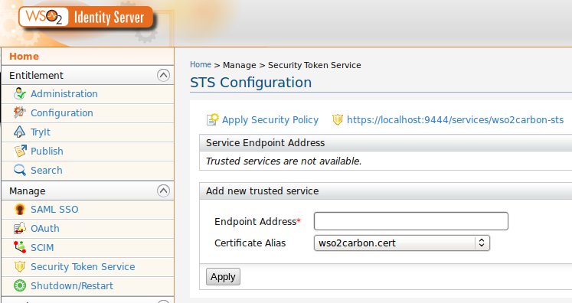
Policy Management Workflow: Use-Case Scenario
Policy Enforcement
Receive Request
Evaluate Request
Policy Decision
Admin Policies
Service Request
Notes:
CV first sends a service request to the STL
Once request is received, it is evaluated against admin specified policies.
Based on request and supporting rules, a decision is made and enforced.

Slide 23
Policy Uniformity
Achieving desired workflow requires uniform Policy Definition
Rule# | Subject | Resource | Target | Attribute | Action | Effect
Policy Classification
Operational Policies focus on enforcement of operation constraints in a GORE infrastructure.
Network Policies focus on maintenance of secure communication channel.
Security Policies focus on authenticating and authorizing access requests.
Notes:
Policy Uniformity and classification : Why ? -> Dealing with multiple services in GORE. Dealing with multiple types of request. How to specify these requriements so the system can understand them.
Some network policies use their own syntax which may not be recognized by another system. That’s why we need a uniform policy specification that will allow the system to easily specify, recognize and evaluate the request against created policies.
Policy Definition:
Subject: request resources/services from a target
Resource: applications available for public authorized use
Target: entities that host application/resources.
Attributes: unique identifiable entities associated with a user/ device.
Action: activity performed on a resource
Effect: Result for a specific rule if all conditions are met.
Policy Classification:
Operational Policy Specifications: Focus on enforcement of operation constraints in a GORE ecosystem to prevent misuse and potential breach of unauthorized data.
Network Policy Specifications: Focus on maintenance of secure communication channel, network load balancing and network QoS requirements.
Security Policy Specifications:
Focus on authenticating and authorizing access requests between various GORE components and smart devices.
Ensuring policy specifications are met for multi-tenant applications.
Policy Specifications: Schema
Data Schema: set of defined attributes associated with interacting components both physical and virtual.
Policy Schema: Set of defined conditions associated with a requested actions which when satisfied performs the requested transaction

Slide 24
Policy Specification – Data Schema
XML
<?xml version="1.0" encoding="UTF-8”?>
<!--Document created by: Clinton Dsouza; Gail-Joon Ahn, SEFCOM-ASU -->
<Specification-1 Target="STL1.0” Requester="CV01” Resource="Authentication-Device">
<Attributes Authentication="X.509” UUID="CV01" GPS-Lat="33.4545"
GPS-Long="-111.98787” Time="7:30:00pm">CV01</Attributes>
</Specification-1>
<Specification-2 Target="FN01” Requester="STL1.0” Resource="Authentication-User">
<Attribute Security Token="X.509” UUID="STL1.0" Location="Tempe,AZ"
Time="7:30:01">STL1.0</Attribute>
</Specification-2>
Notes:
Attributes associated with interacting components.

Slide 25
Policy Specification – Policy Schema
XACML
<Policy PolicyId="McClintock_Dr_and_ApacheBlvd_Policies" RuleCombiningAlgId="rule-combining-algorithm:deny-unless-permit" Version="1.0">
<Target>
<AnyOf>
<AllOf>
<Match MatchId="function:string-equal">
<AttributeValue>McClintock_Dr_and_ApacheBlvd</AttributeValue> </Match>
</AllOf> </AnyOf> </Target>
<Rule Effect="Permit" RuleId="20">
<Target>
<AnyOf>
<AllOf>
<Match MatchId="function:string-equal">
<AttributeValue>update</AttributeValue>
</Match>
<Match MatchId="function:string-equal">
<AttributeValue DataType="http://www.w3.org/2001/XMLSchema#string">TrafficService</AttributeValue>
</Match> </AllOf> </AnyOf> </Target> <Condition>
<Apply FunctionId="and">
<Apply FunctionId="urn:oasis:names:tc:xacml:1.0:function:and">
<Apply FunctionId="urn:oasis:names:tc:xacml:1.0:function:string-at-least-one-member-of">
<Apply FunctionId="urn:oasis:names:tc:xacml:1.0:function:string-bag">
<AttributeValue DataType="http://www.w3.org/2001/XMLSchema#string">ECV</AttributeValue>
<AttributeValue DataType="http://www.w3.org/2001/XMLSchema#string">CV</AttributeValue>
</Apply> </Apply> </Apply> </Condition> </Rule>
Notes:
Defined conditions associated with a requested actions.

Slide 26
STS Policy
Rule# | Subject | Resource | Target | Attribute | Action | Effect
1 | CV, ECV | Health Service | STL | { CLoc: Mill Ave. & 7th St., Tempe, ; Current_TimeStamp: 09:59:00 am < Time < 6:00:00 pm} | Access | Deny
2 | ECV | Health Service | STL | { CLoc: Mill Ave. & 7th St., Tempe, ; Current_TimeStamp: 01:00:00 am < Time < 11:59:00 pm} | Update | Permit
3 | CV | Direction Service | GN | { CLoc: McClintock Drive & Apache Blvd., Tempe, AZ; Current_TimeStamp: 09:00:00 am < Time < 07:59:00 pm} | Access | Permit
4 | ECV,CV | Direction Service | GN | { CLoc: McClintock Drive & Apache Blvd., Tempe, AZ; Current_TimeStamp: 01:00:00 am < Time < 11:59:00 pm} | Access | Permit
5 | ECV, CV | Direction Service | GN | { CLoc: McClintock Drive & Apache Blvd., Tempe, AZ; Current_TimeStamp: 09:00:00 am < Time < 06:00:00 pm} | Update | Deny
6 | ECV, CV | User Profile | STL | { CLoc: McClintock Drive & Apache Blvd., Tempe, AZ; Current_TimeStamp: 09:00:00 am < Time < 06:00:00 pm} | Access | Permit
8 | CV | User Profile | STL | { CLoc: Mill Ave. & 7th St., Tempe, AZ; Current_TimeStamp: 01:00:00 am < Time < 11:59:00 pm} | Access | Permit
9 | CV | Traffic Service | GN | { CLoc: McClintock Drive & Apache Blvd., Tempe, AZ; Current_TimeStamp: 9:00:00 am < Time < 12:59:00 pm} | Update | Deny
10 | ECV | Traffic Service | GN | { CLoc: Mill Ave. + 7th St., Tempe, ; Current_TimeStamp: 1:00:00 pm < Time < 11:59:00} | Access | Permit

Slide 27
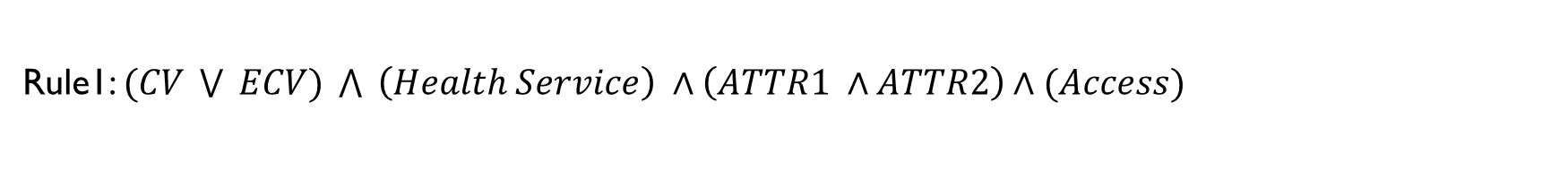
Conflict Detection Technique
Approach: Policy-Based Segmentation
Classify the disjoint conflicting rules in a policy.
Atomic Boolean Expressions
Extract vital information stored in rules.
Binary Decision Diagram (BDD): Enables realization of the effectiveness of segmentation approach.
Rule# | Subject | Resource | Target | Attribute | Action | Effect
1 | CV, ECV | Health Service | STL | { CLoc: Mill Ave. & 7th St., Tempe, ; Current_TimeStamp: 09:59:00 am < Time < 6:00:00 pm} | Access | Deny
Rule1: $(CV \bigvee{ ECV) \bigwedge{ \left(Health Service\right) ∧\left(ATTR1 ∧ATTR2\right)∧(Access)}}$
Notes:
Conflicts analyzed at Policy level
BDD is widely for formal verification and simplification of digital circuits.
We decided to utilize this as a method for simplification of rules for better verification and integration with our segmentation approach.

Slide 28
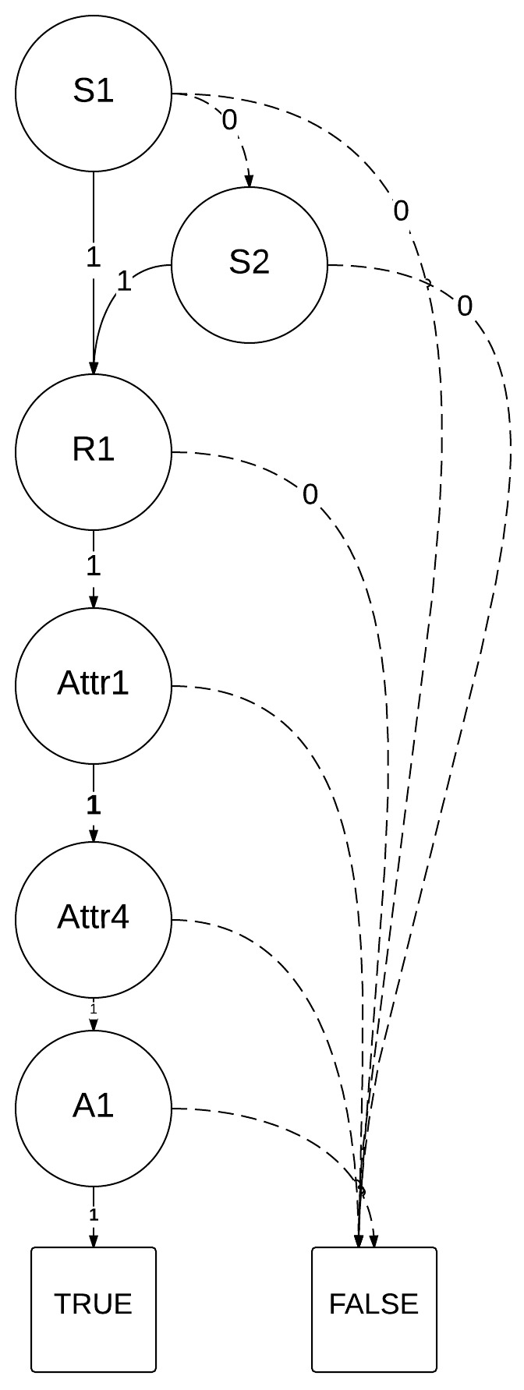
BDD Sample – Rule
Rule# | Subject | Resource | Target | Attribute | Action | Effect
1 | CV, ECV | Health Service | STL | { CLoc: Mill Ave. & 7th St., Tempe, ; Current_TimeStamp: 09:59:00 am < Time < 6:00:00 pm} | Access | Deny

Slide 29
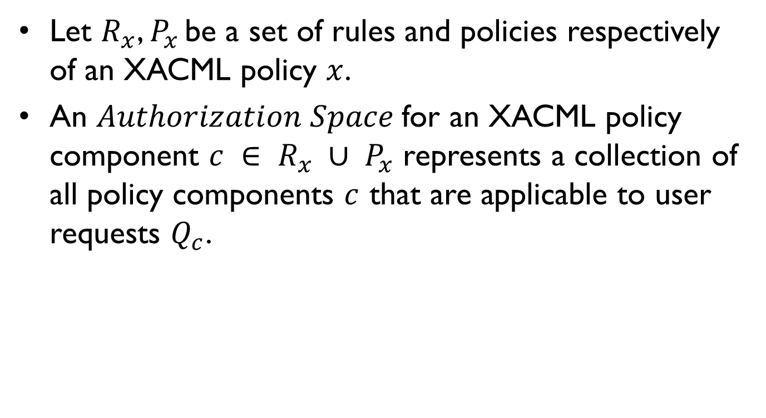
Authorization Space
Let $R_{x}$, $P_{x }$be a set of rules and policies respectively of an XACML policy $x$.
An $Authorization Space$for an XACML policy component $c ∈ R_{x} ∪ P_{x}$ represents a collection of all policy components $c$ that are applicable to user requests $Q_{c}$.
Notes:
Realization of a Policy based segmentation approach required the introduction of 2 new concepts
Realization of a Policy based segmentation approach required the introduction of 2 new concepts.
Authorization Space adopts the BDD based policy representation to perform policy analysis.
It represents a collection of policy components more specifically, against which a user request can be evaluated to.
Authorization Space, consists of rules which are segmented for conflict detection.

Slide 30
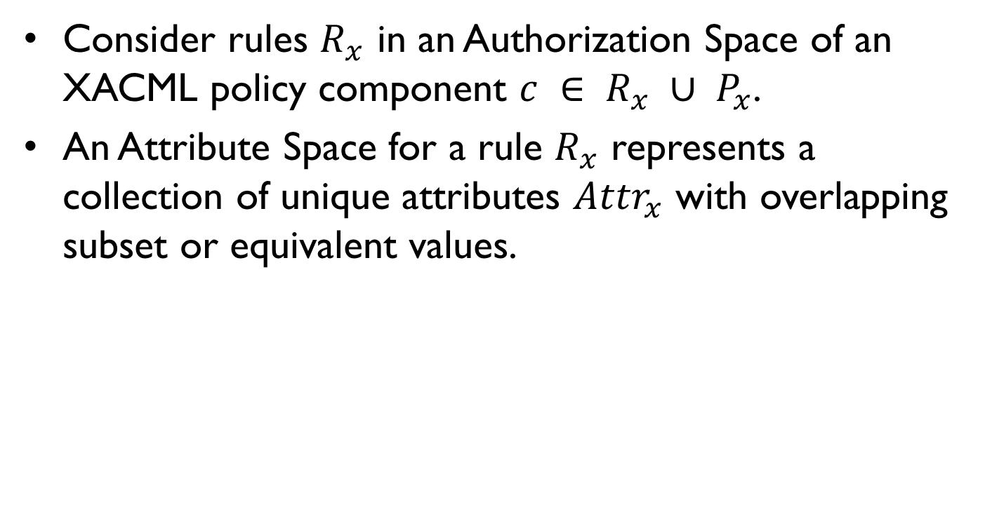
Attribute Space
Consider rules $R_{x}$ in an Authorization Space of an XACML policy component $c ∈ R_{x} ∪ P_{x}$.
An Attribute Space for a rule $R_{x}$ represents a collection of unique attributes ${Attr}_{x}$ with overlapping subset or equivalent values.
Notes:
Once an authorization space is identified, unique attributes for rules within the authorization space needs to be extracted. These attributes can be equivalent or may even overlap. This collection allows for efficient resolution of conflicting policies.

Slide 31
Conflict Detection Algorithm
Input: A policy with a set of rules.
Create a new segment.
Create a new conflicting segment space.
Partition the policy.
Evaluate each rule and partition the policy into Authorization Spaces.
An Attribute Space is determined from an Authorization Space.
Partition the authorization spaces.

Slide 32
Determining Conflicting Rules in Authorization Space
Partition the authorization space using set operations.
Subset: rule r_{i} contains elements which are part of r_{j}.
Superset: r_{j} contains all elements of a smaller set r_{i}.
Equivalent: r_{i} contains all elements as in r_{j}.
Append the conflicting rules to a segment.
For every conflicting rule found in a segment.
Extract the rule.
Append to the conflicting segment.
Notes:
Authorization space is derived from a policy component is first partitioned into set of disjoint segments.
This is achieved utilizing set operations.

Slide 33
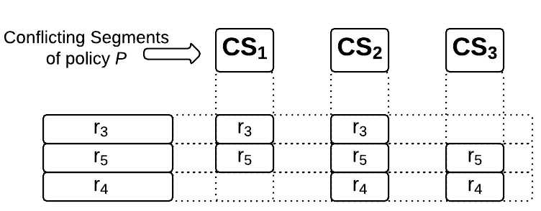
Grid Representation
Rule# | Subject | Resource | Action | Attribute | Action | Effect
3 | CV | Direction Service | GN | { CLoc: McClintock Drive & Apache Blvd., Tempe, AZ; Current_TimeStamp: 09:00:00 am < Time < 07:59:00 pm} | Access | Permit
4 | ECV,CV | Direction Service | GN | { CLoc: McClintock Drive & Apache Blvd., Tempe, AZ; Current_TimeStamp: 01:00:00 am < Time < 11:59:00 pm} | Access | Permit
5 | ECV, CV | Direction Service | GN | { CLoc: McClintock Drive & Apache Blvd., Tempe, AZ; Current_TimeStamp: 09:00:00 am < Time < 06:00:00 pm} | Update | Deny
Notes:
The grid representation thus allows us to interpret the conflicts detected in these rules.
As discussed earlier, r5 is a common conflicting rule, and on closer examination will show that since the rule has an effect of deny it conflicts with r3 and r4.
Based on the use case scenarios discussed earlier, we observe that the conflicting rules create a situation where an ECV is being denied access to resources during certain time slots which conflicts with rules specified to allow continued access to an ECV.
In addition to conflicting rule effects, there is also a conflict in their time range attribute, which contributes the addition of rules to a conflicting segment and ultimately the visualization of the grid representation.

Slide 34
Policy Resolution Algorithm
Utilize set operations and administrative inputs.
Admin Choices
Superset Priority
Subject Priority
Algorithm has 2 sections
Rules with same effects
Evaluate attributes utilizing set operations inclusive of admin choice.
Based on results remove the conflicting rule.
Rules with different effects
Evaluate the subjects and attribute values.
Based on attribute comparison and admin choice utilize set operations.
Based on evaluation, conflicting rules are removed.
If the rules are the same but different effect, the Policy Combining Algorithm will resolve it.
Notes:
Analyze conflicting segments in Authorization Spaces to determine conflicting entities in rules.
XACML has 4 default PCA : Permit Override, Deny Override, Deny Unless Permit, Permit unless deny.

Slide 35
Sample Resolved Rules
Rule# | Subject | Resource | Action | Attribute | Action | Effect
3 | CV | Direction Service | GN | { CLoc: McClintock Drive & Apache Blvd., Tempe, AZ; Current_TimeStamp: 09:00:00 am < Time < 07:59:00 pm} | Access | Permit
4 | ECV,CV | Direction Service | GN | { CLoc: McClintock Drive & Apache Blvd., Tempe, AZ; Current_TimeStamp: 01:00:00 am < Time < 11:59:00 pm} | Access | Permit
5 | ECV, CV | Direction Service | GN | { CLoc: McClintock Drive & Apache Blvd., Tempe, AZ; Current_TimeStamp: 09:00:00 am < Time < 06:00:00 pm} | Update | Deny
Conflicting Rules
Resolved Rule

Slide 36
Implementation
Overview Goal
Demonstrate the effectiveness of the GORE architecture.
Components Involved
Cloud data centers, mobile devices, and cyber-physical devices.
System Goal
Accommodate the dynamic workflow achieved through the implementation of a GORE-like infrastructure.
Realize the functionalities expected in a Smart Transportation System.

Slide 37


System Design
Cloud Data Centers
Gateway Nodes
Connected Vehicles

Slide 38
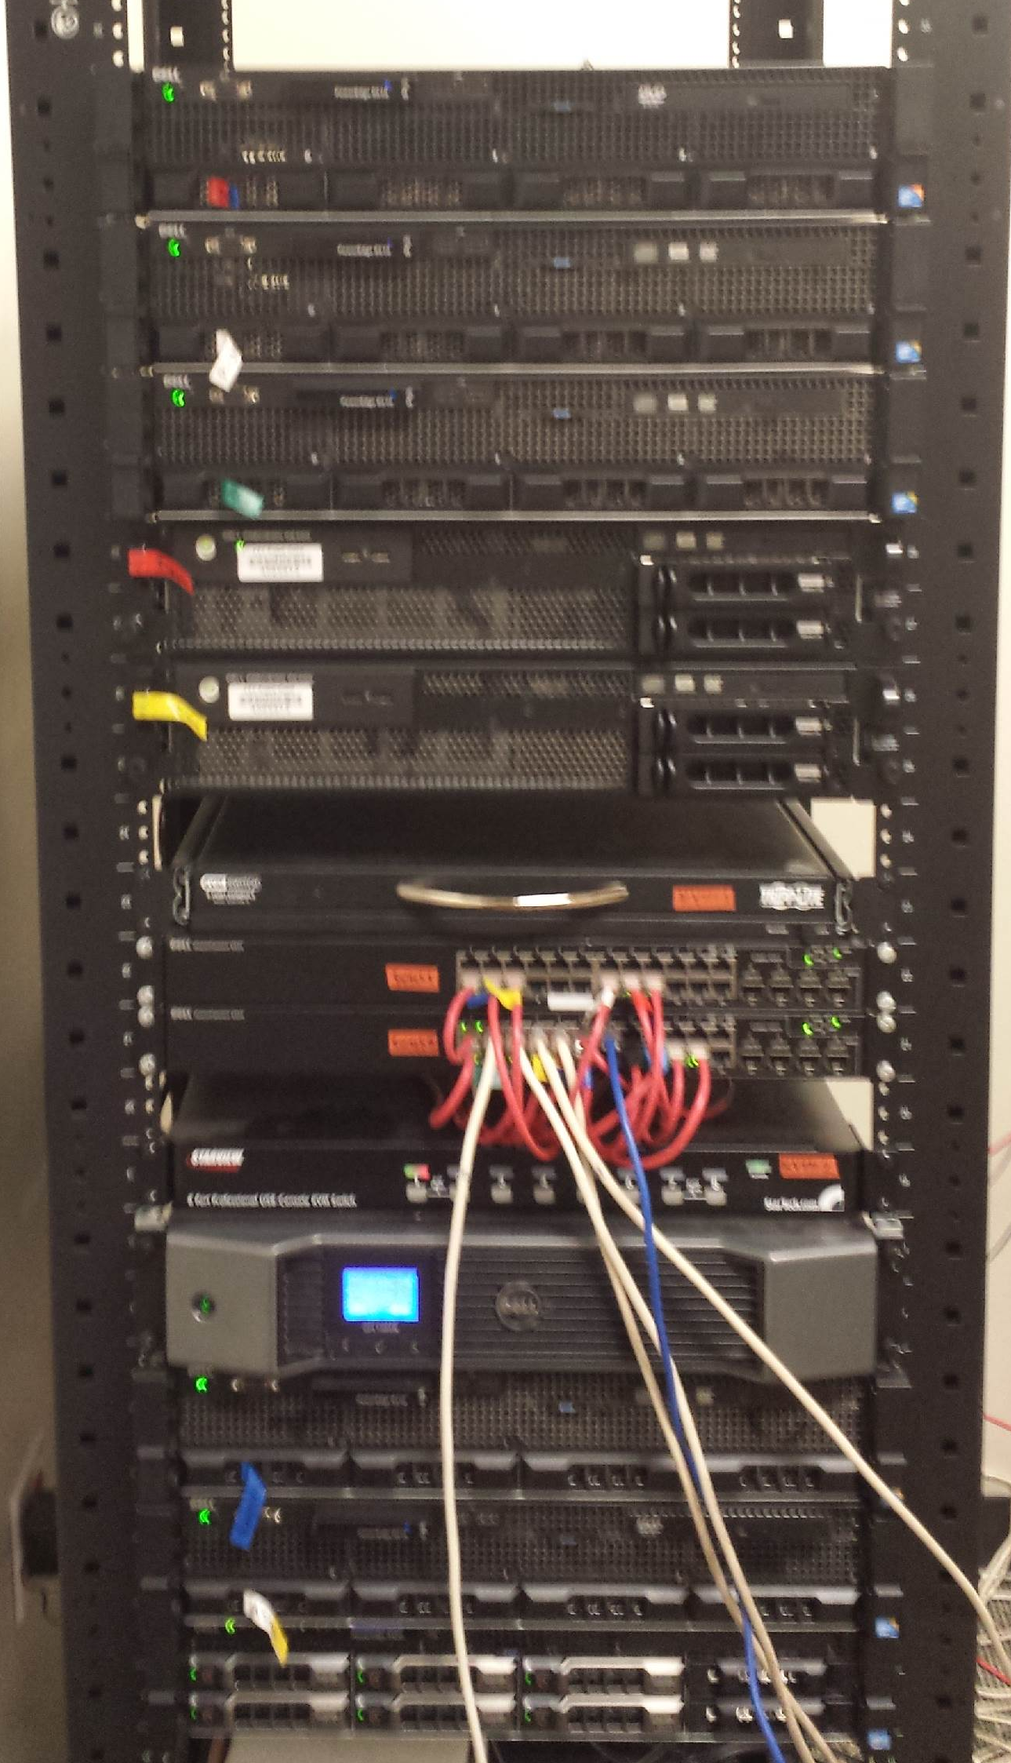
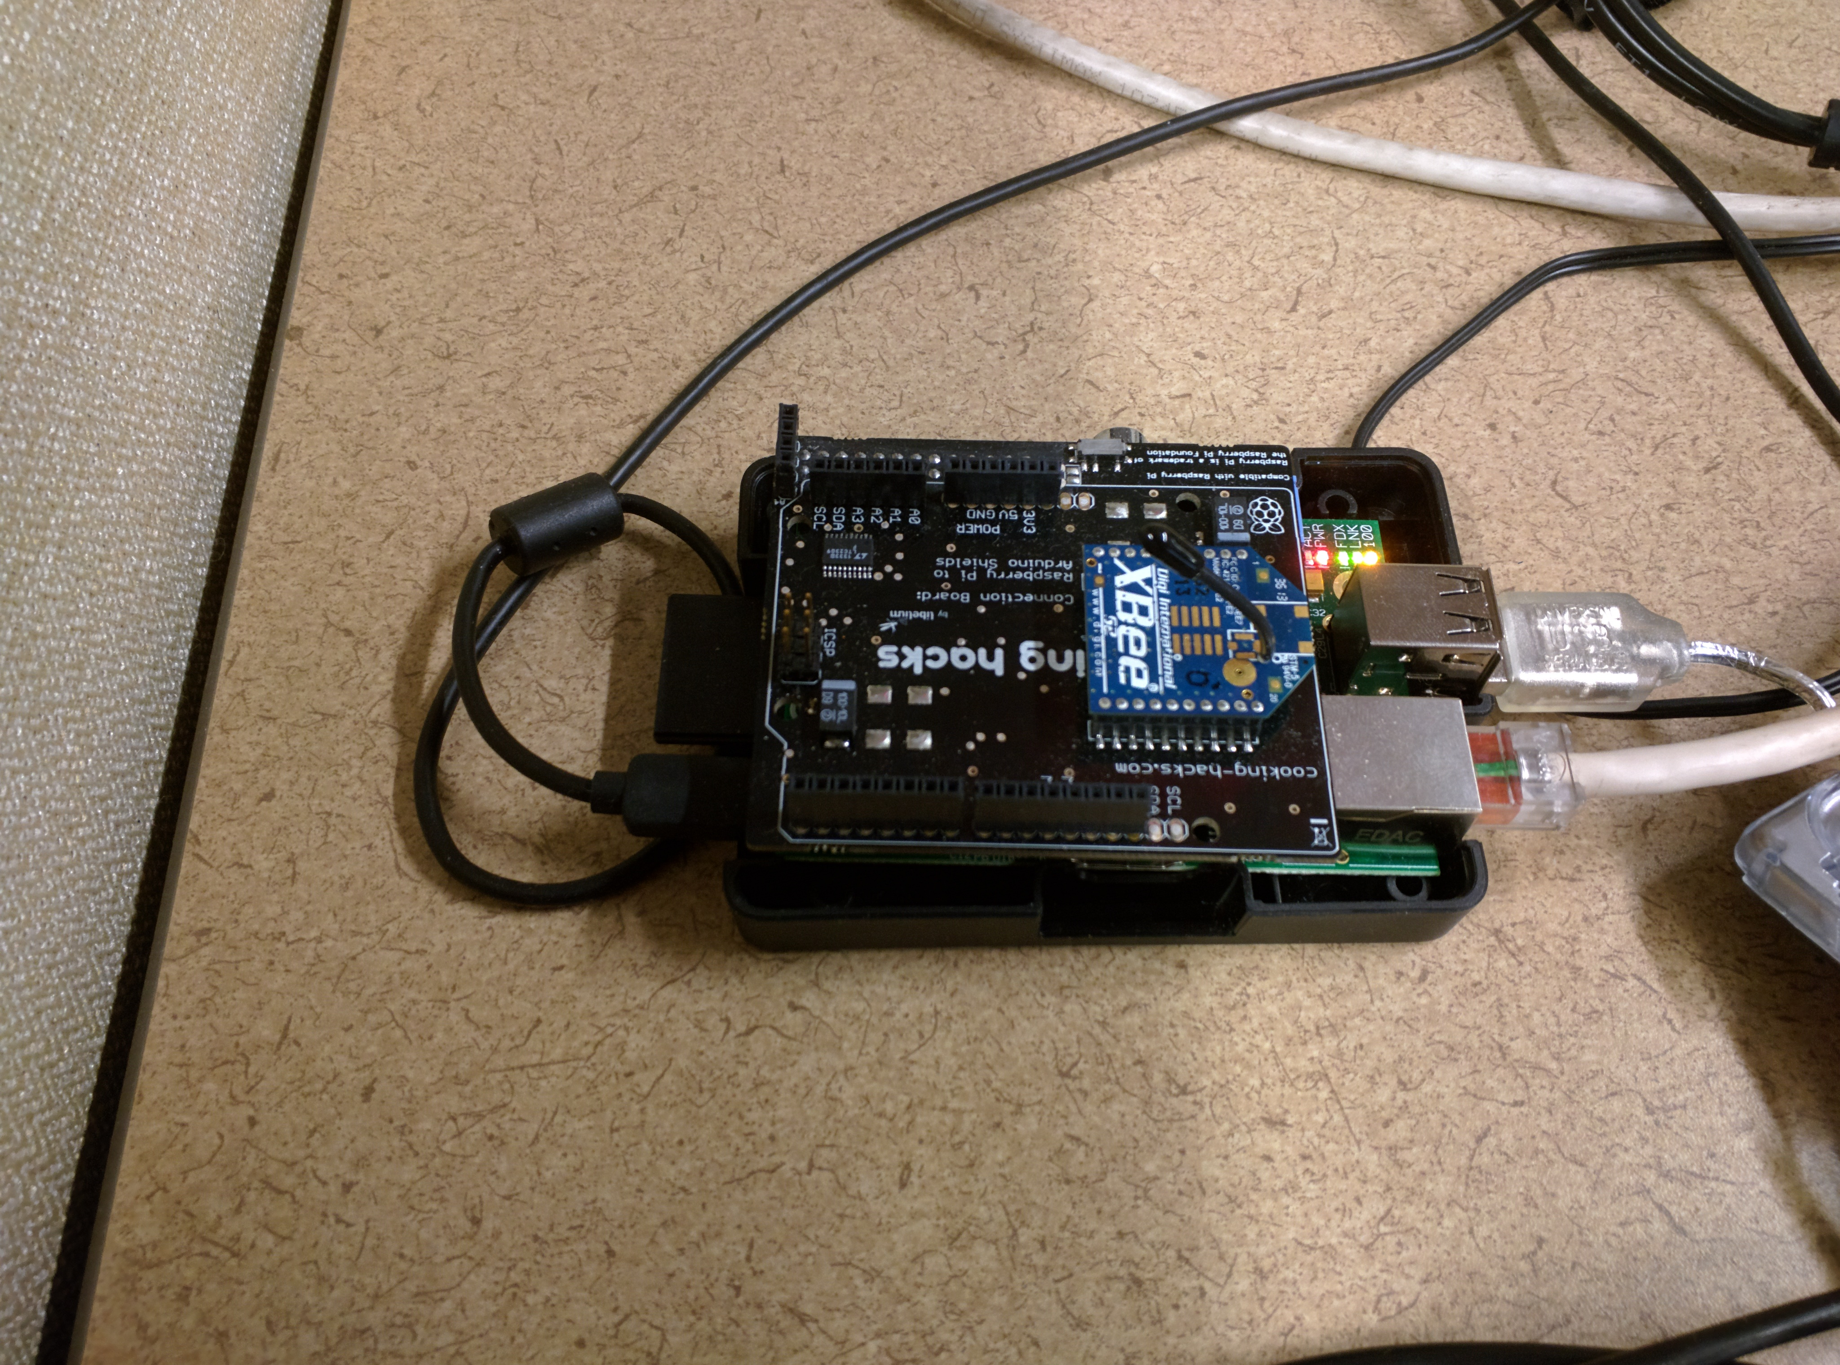
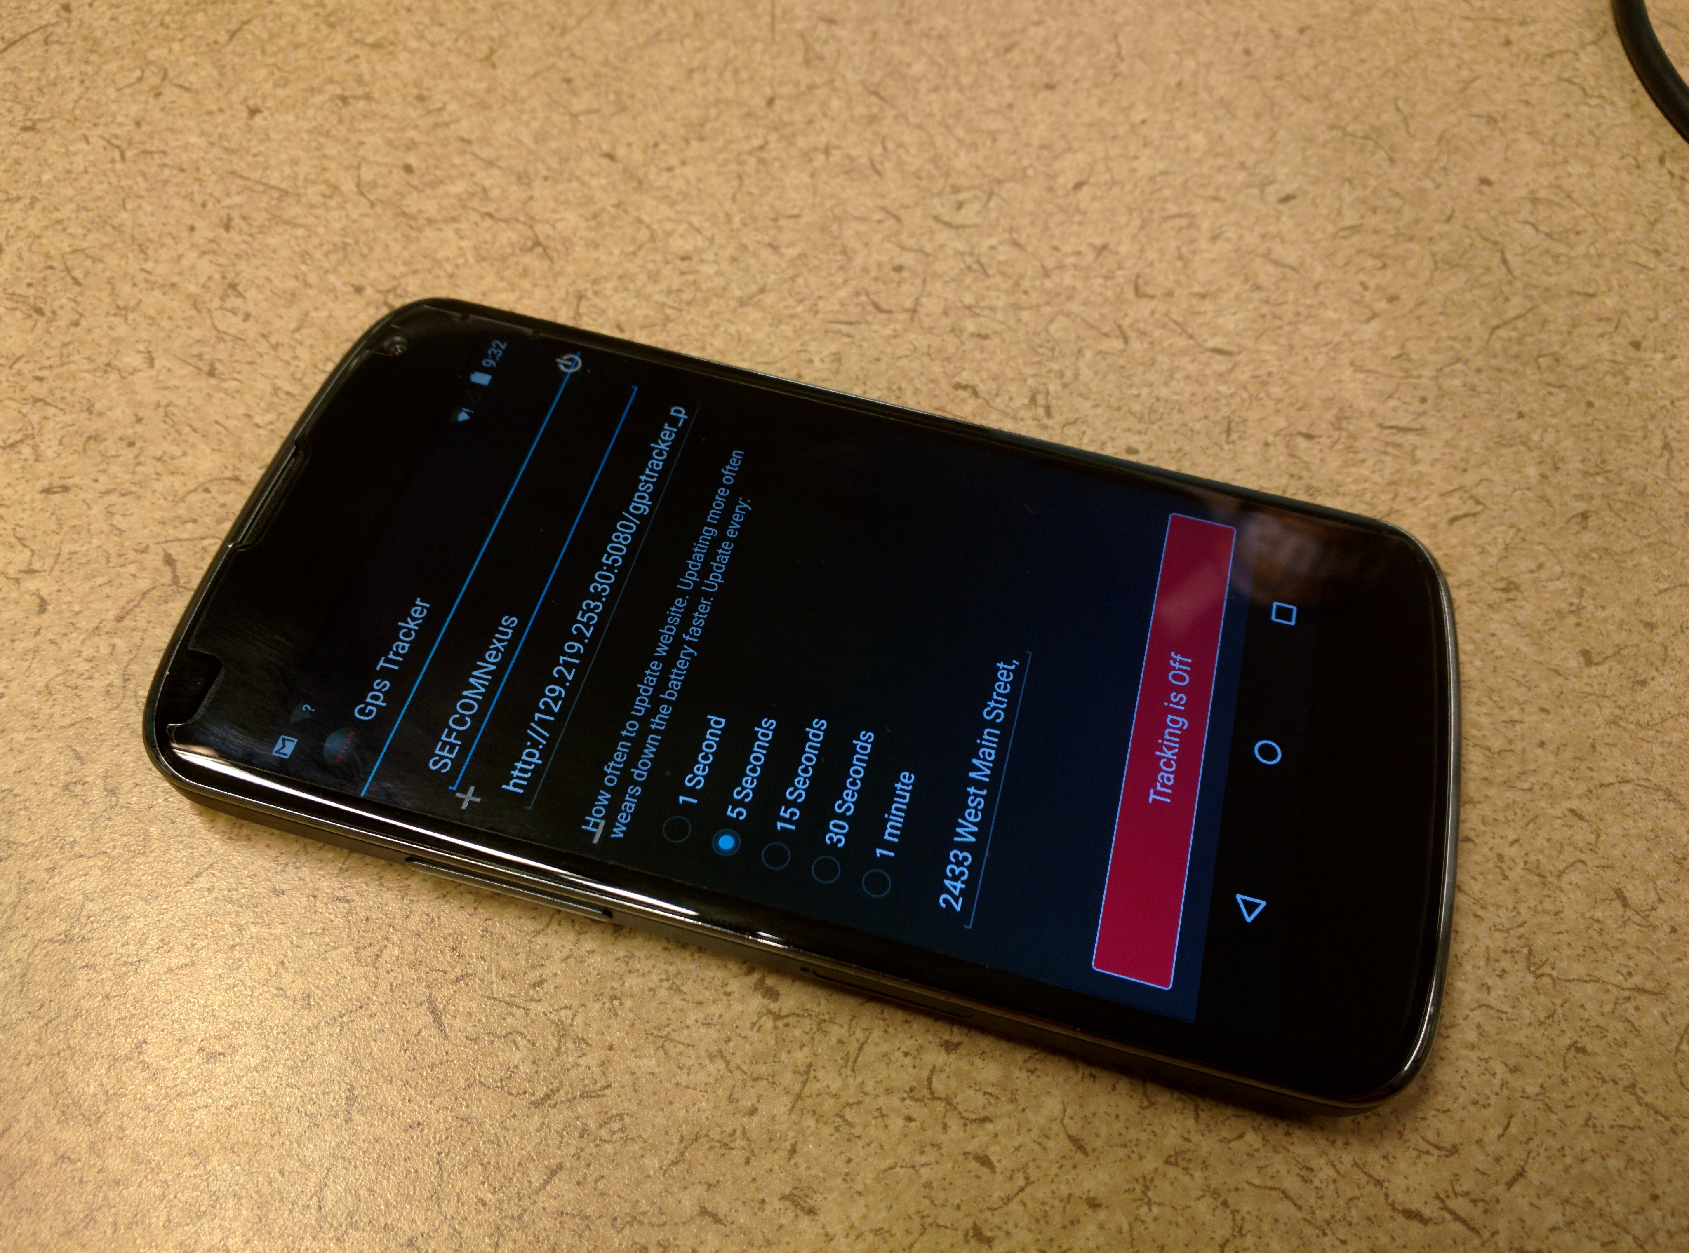
Physical Devices
OpenStack Cloud
Cloud Data Center
SEFCOM Servers
Raspberry- Pi
Gateway Node
Nexus 5
CV

Slide 39
Test Bed Workflow
OpenStack Instances
Policy Administrator
Front-End UI
System Information
Google Direction Service (3rd Party)
Raspberry - Pi
User Information
Policy Repository
Policy Enforcer
Policy Decision Engine
Service Request
Android Application

Slide 40
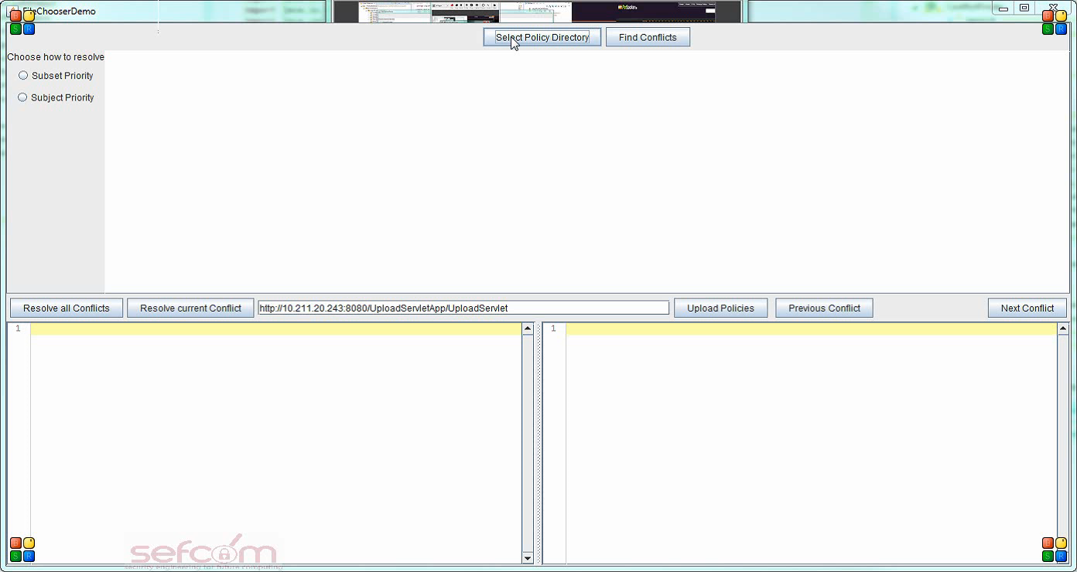
Test-Bed Demo – Admin Console

Slide 41
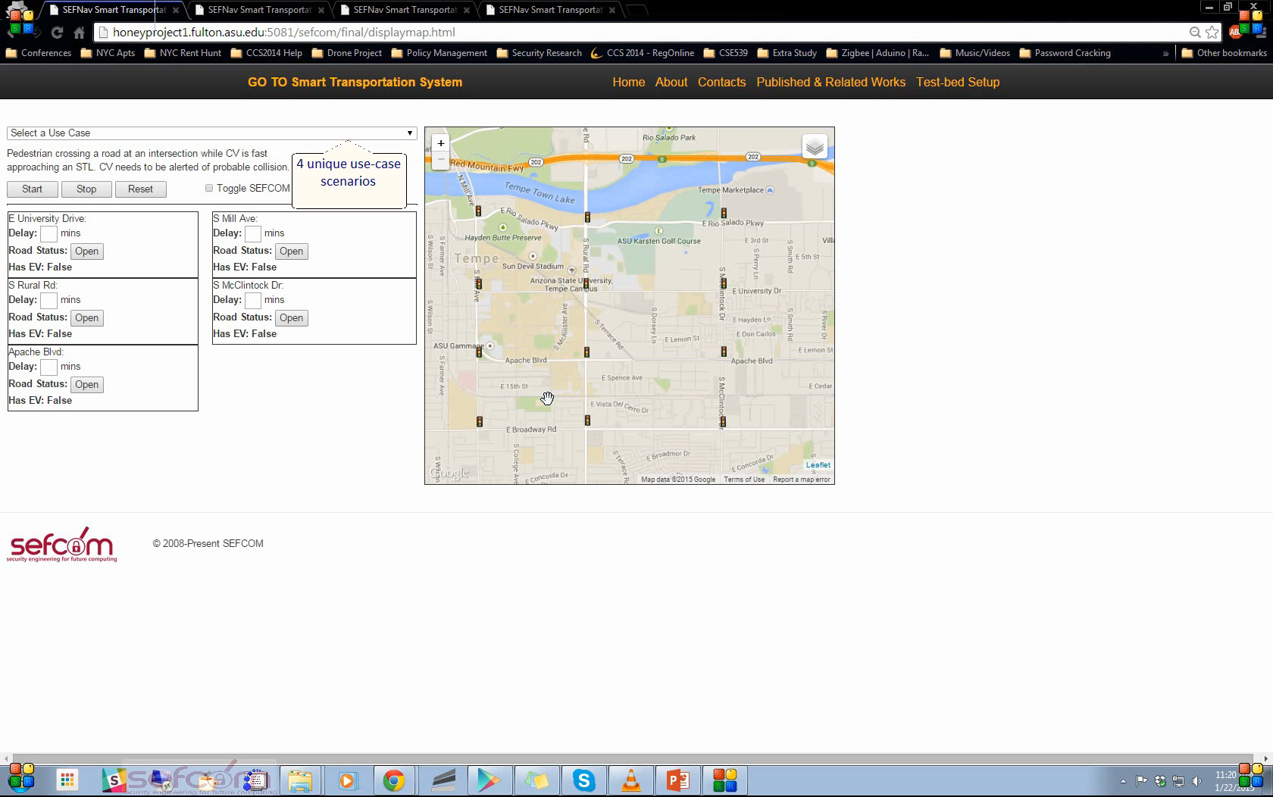
Test-Bed Demo – System

Slide 42
Administrative Console Evaluation
Notes:
From admin perspective , we evaluated the policies and determined the number of conflicts. The conflicts were of varying types and the resolution method utilized was a superset priority. With the increase in the number of rules and conflicts time for detection and resolution of conflicts did increase but not significantly.

Slide 43
Policy Engine Evaluation
Notes:
We performed 3 evaluations on the policy engine side:
We evaluated the Policy enforcement time versus the number of vehicles
We evaluate the Policy Decision time versus the number of vehicles
We evaluate the Attribute Resolution Time vs number of vehicles.

Slide 44
Future Work – GORE
Development of a security service module
Each GN or GI can host a security module.
Module consists of
Policy Management framework and Life-Cycle management.
Security communication encryption.
Intrusion Detection.
Identity Management and User entitlement services.
Each module is independent and can be configured based on GORE infrastructure.
Self-Healing System
Monitor health of the GN and GI.
Detect when system is compromised and spawn another GN or GI.
Enable GORE to function as a self-sustaining system.

Slide 45
Future Work – Policy Management
Multi-dimensional policy structure
Based on 3 policy requirements, a multi-dimensional policy structure can be constructed based on placement of the policies.
Virtual
Tenant
Policy Structure
Client

Slide 46
Future Work – Policy Management
Dynamic Policy Management Framework
Continuously evaluate GORE infrastructure and resource usage.
Generate policies to better manage the GORE environment and its communication infrastructure.
Existing work proposed by David Puzolu only considered network management systems.
Need to evaluate security, operational, and network policies dynamically.

Slide 47
Conclusion
Introduced Gateway-Oriented Reconfigurable Ecosystems (GORE)
Homogeneity in distributed environment.
On-demand access, low latency and geographical localization of services.
Proposed Policy Management module for GORE
Uniform collaboration and communication.
Robust policy conflict detection and resolution module.

Slide 48
Contributions – GORE
Low-latency, robust infrastructure that sits at the edge of the network.
Architecture design enables cyber-physical systems to interact with IoTs and provision services in real-time.
Interoperable ecosystem that enables disparate and diverse systems, components and entities to communicate and collaborate information.
Client-centric approach towards collaboration and management of resources and applications.

Slide 49
Contributions – Policy Management
Introduced a robust policy management framework to ensure creation of an interoperable ecosystem.
Efficient conflict detection and resolutions algorithms for policies in a GORE ecosystem.
Utilized Policy-based segmentation approach towards the design of policy conflict detections and resolution algorithms.
User-centric approach towards policy management, where, users are in control of deciding final resolution technique.

Slide 50
Acknowledgement
This work was partially supported by grants from Cisco Inc. We would like to thank Dr. Rodolfo Milito for his support and feedback in refining the proposed approach in this project.
Dsouza ,C., Ahn, G-J., Taguinod, M., “Policy-Driven Security Management for Fog Computing: Preliminary Framework and A Case Study, ” In Proceedings of the 15th IEEE International Conference for Information Reuse and Integration (IRI), August 2014.

Slide 51


Slide 52
Backup Slides

Slide 53
Security Criteria
Each GN and GI requires a certain level of security.
Common security concern is communication
Each node and instance should perform actions within specified limits.
These limits should be determined by owner and tenant.
Need for uniform security governance.
Policy Management is a potential solution to secure, uniform, and interoperable communication among diverse applications and connecting devices.
Notes:
Multiple Gateway Instances and clients connect to a single Gateway Node to provide resource support.

Slide 54
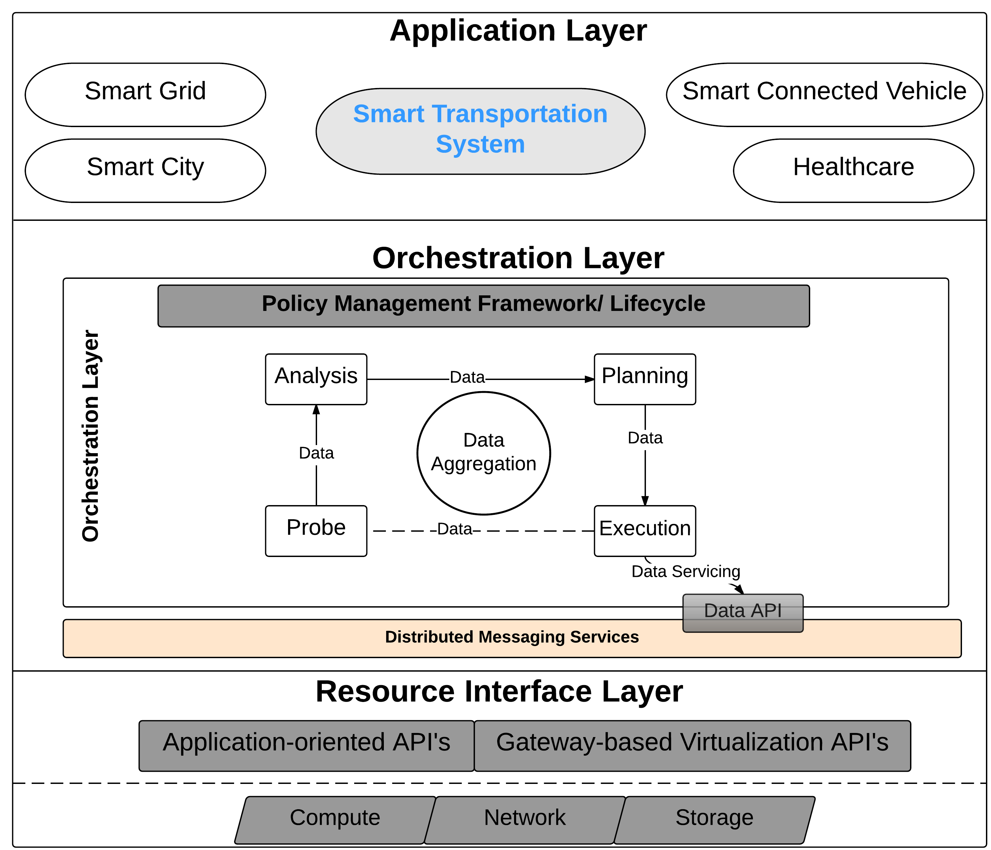
Policy Management Framework

Slide 55


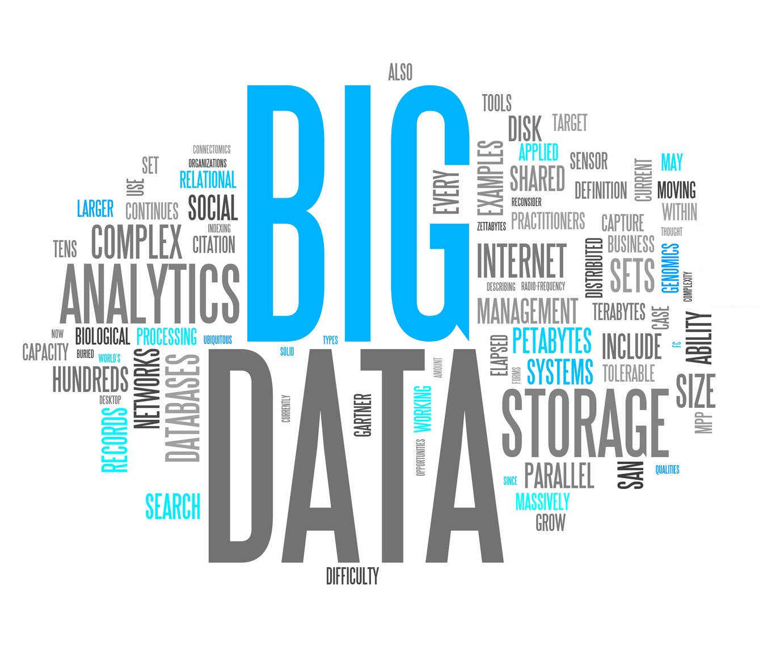
Motivation
Where?
RESEARCH MOTIVATION
What?
Why?

Slide 56
Internet of Thing
“Network of physical objects with the capability of communicating with associated smart connected devices wither directly or via the internet”
Connects remote assets and provides a data stream.
Generates large quantities of data that need to be processed and analyzed in real time.
“The Rise of IoT” –
Samsung, Panasonic, Sony and Mercedes:
IoT and ADAS, next Big Thing after smartphones.
Committed to contributing to ecosystem for hosting IoTs.
Notes:
Physical objects range from Health-Care monitoring devices and smart-watches to industrial manufacturing devices.
Data stream is between assets and centralized management
In CES 2015 press conference, these four companies committed towards the development of IoTs and an ecosystem to sustain them.
Advanced Driver Assistance Systems and IoT are the next big things after smartphones

Slide 57
Internet of Everything
IoT has evolved:
Personalized to a user
Capability to share sensitive data
Capability to communicate with similar IoT-based devices
Internet of Everything (IoE)
“bringing together people, process, data and “things” to make networked connections more relevant and valuable”
Notes:
IoE concepts brings multiple moving components together and results in the generation of large quantity of data.

Slide 58
Big Data
“Data which exceeds the capacity of capability of current or conventional methods and systems”
KPMG: ~30% increase in digital data explosion from 2011 – 2012.
Data storage requirement estimated to increase to 35 Zettabytes(ZB) by 2020.
Cisco: Annual global data center IP traffic will reach 8.6 ZB by the end of 2018.
~$14.4 trillion market value availability for IoE-based devices.
Global data created by IoE will reach 403 ZB/ year by 2018

Slide 59
Cloud Computing
“Enabling ubiquitous, convenient, on-demand network access to shared pool of configurable computing resources that can be rapidly provisioned and released with minimal management effort or service provider interaction.”
Considered to be an effective solution to the Big Data problem.
RainStor, Hadoop, QlikView, Cloudera, Acunu and more
Centralized data model for large quantity storage.
IoTs being “smart” do not require large data centers.
Notes:
IoTs can :
Process data within themselves rather than requiring a trip to the cloud.
IoTs would need a decentralized data model where only relevant data and virtualization resources are combined, creating a web of connectivity

Slide 60
The Cloud Conundrum
Current Cloud models are centralized.
IoTs require a decentralized approach to data analysis and aggregation.
A paradigm is required that would sit between smart devices and the cloud data centers.
A paradigm with the capability to sit at the “edge-of-the-network”.
Geo-distribution, mobility and low-latency are few key requirements for such a computing paradigm.

Slide 61
GORE and IoT
IoT create a data explosion- Big Data.
Big Data problem: large quantitative and analytical aggregation requirements with higher wait times.
Creates hindrance for real-time data aggregation and robust communication support.
Utilizing GORE paradigm:
realization of near real-time response, through distributive localized systems is achieved for IoTs interacting in this interoperable system.
Notes:
IoTs create a data explosion with billions of devices communicating with the web, uploading and downloading data in the cloud.
Data explosion leads to large quantitative analytical aggregation and higher wait times.
Big Data problem creates hindrance to real-time data aggregation and robust communication support.
Utilizing GORE paradigm, the realization of near real-time response, through distributive localized systems is achieved for IoTs interacting in this interoperable system.

Slide 62
GORE vs Cloud
Tiered organization in multi-tenant environment.
Hierarchical management, supporting inter-operable distributed computing environments.
Geo-distribution of computational power with extensive focus on service localization.
Distributed and expanded mobility model to enable geo-distributed computing capability.
Orchestration layer supporting coordinated control in multi-tier architectural settings.
Real-time realizations with negligible latency.
Distributed policy management frameworks involving multi-tier policy sets and rules.

Slide 63
Applicability of GORE
Stakeholders:
IoT device developers
IoT frameworks, and ecosystems developers
IoT application owners
Application Environments:
Smart Transportation Systems
Smart Cities
Smart Buildings
Smart Connected Vehicle
Healthcare

Slide 64
Smart Transportation Systems
Intelligent and adaptive systems comprising of multiple components and real-time applications.
Goal:
Accommodate dynamic traffic changes and provide real-time services to commuters, thus creating a safe environment for travel.
Components:
Connected Vehicles
Smart Traffic Lights
Smart Phones (Pedestrians)
Delivery Expectations:
Low latency, dynamic provisioning, and on-demand access to applications

Slide 65
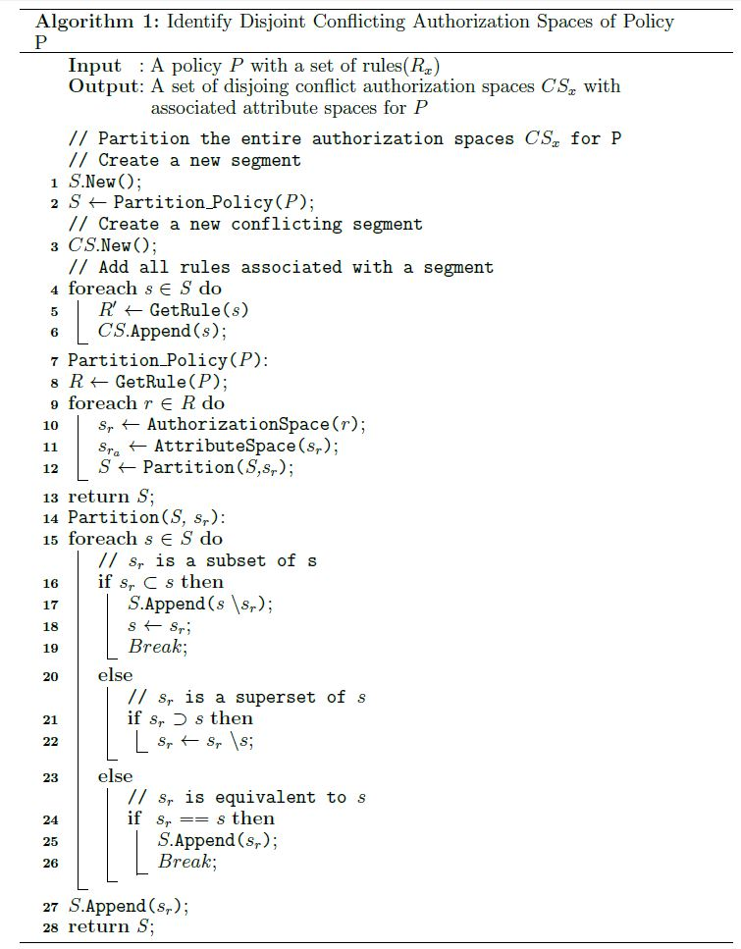
Conflict Detection Algorithm

Slide 66
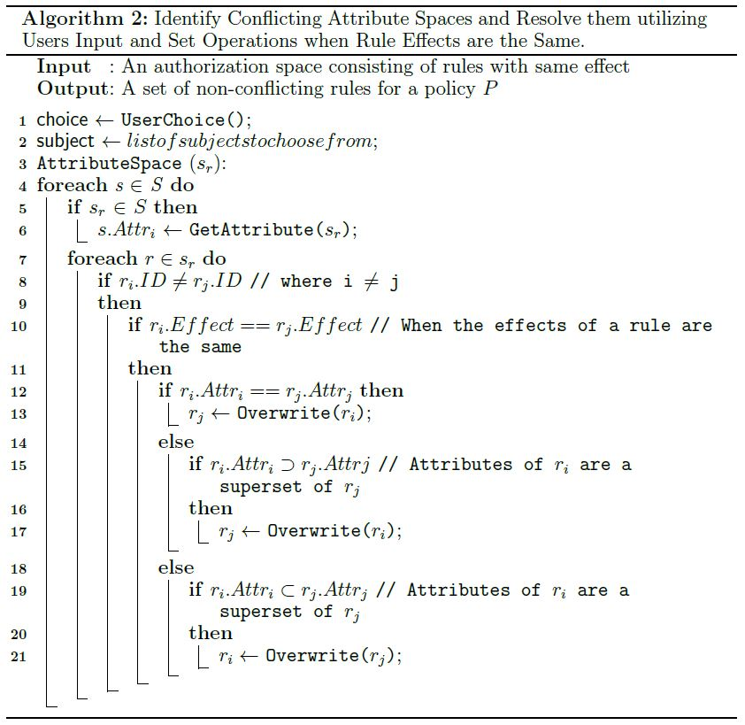
Conflict Resolution Algorithm - I

Slide 67
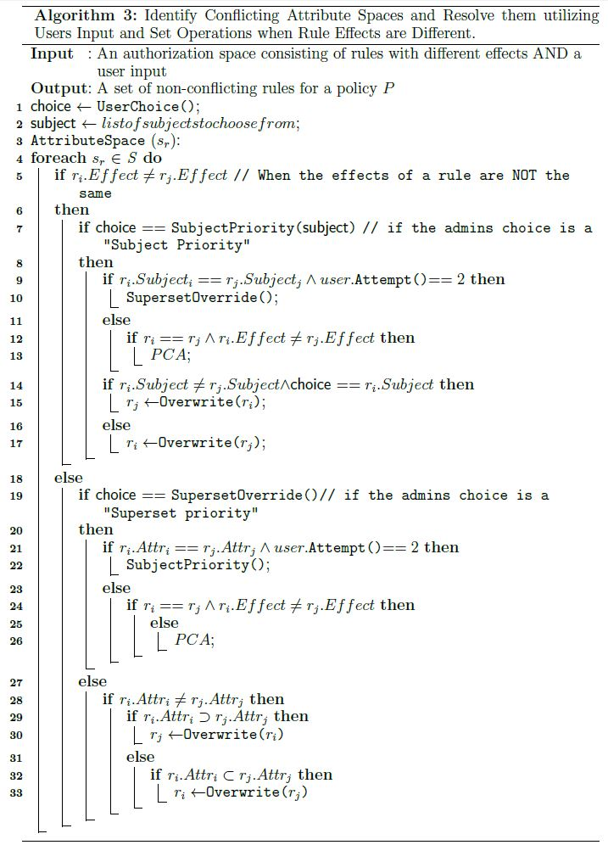
Conflict Resolution Algorithm - I

Slide 68
Contributions – GORE
Infrastructure comprising of 3 unique layers.
Sits at the edge of the network.
Prime location to enable low-latency communication between IoT and Cloud Data Centers.
Focus: Orchestration Layer
Designed to function as the core layer in the GORE infrastructure.
Handles client requests for services including communication.
Independent layers and modules allowing for easy addition and substitution of services.
Notes:
Primary data aggregation for IoT devices occurs in this layer

Slide 69
Contributions – Policy Management
Independent component in the orchestration layer.
Evaluates user requests against specified policies for an application.
Formal definition and specification of policies and rules.
Design and implementation of algorithms
To detect conflicts and resolve them.
Design of a robust policy decision engine.

